Slide 1
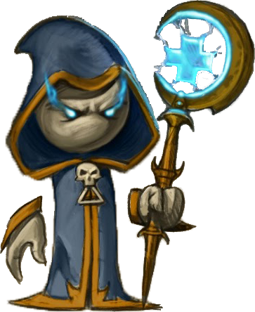

Java Fundamentals
Teamwork Project

Slide 2

Team “Crick”
Bozhidar Tonchev
Georgi Dinev
Natalia Trencheva
Nikolai Nedkov
Stamen Ivanov

Slide 3
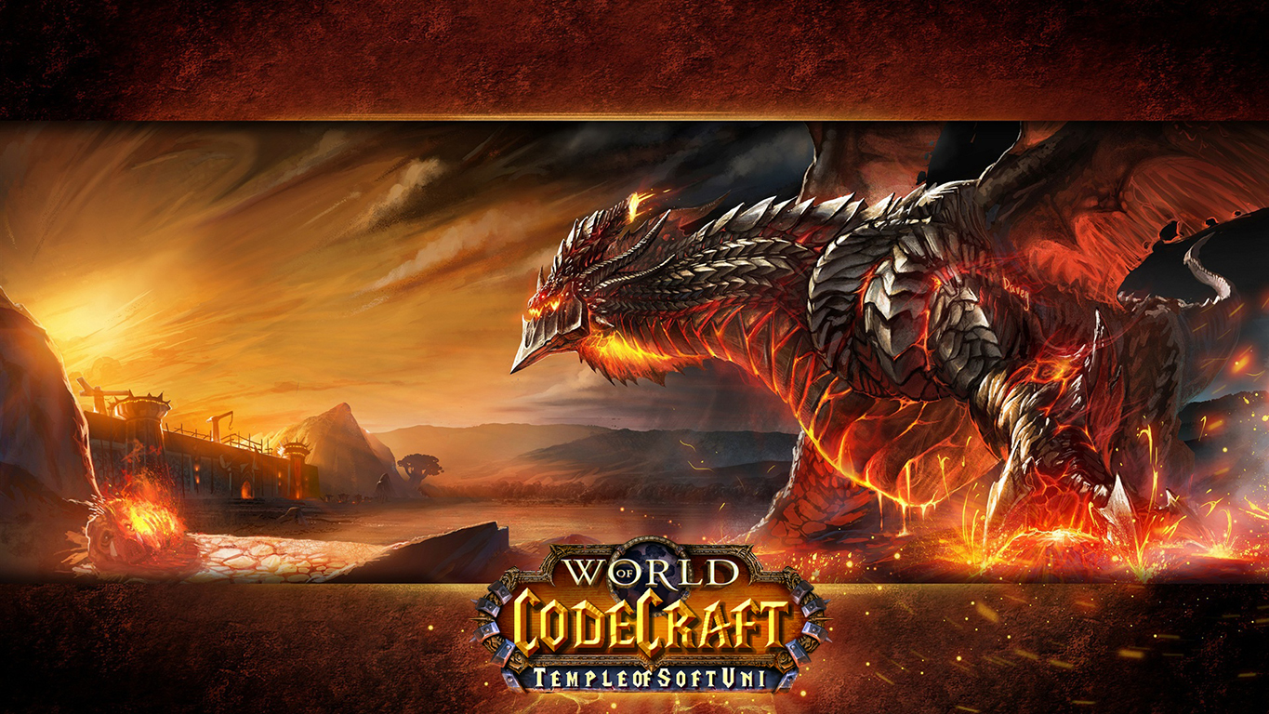

Slide 4
Game Description
The player takes control of selectable character. He is able to move around a map, interact with the environment and shoot.
Heroes – Mage, Paladin, Rogue
Stats – Lives, Ammunition
Enemies – Ghost, Helmet, The Boss

Slide 5
GitHub Repository
https://github.com/bojidartonchev/WorldOfCodeCraft-Team-Crick

